Slide 1
SIM GAME
Minh Nguyen, hau ha

Slide 2
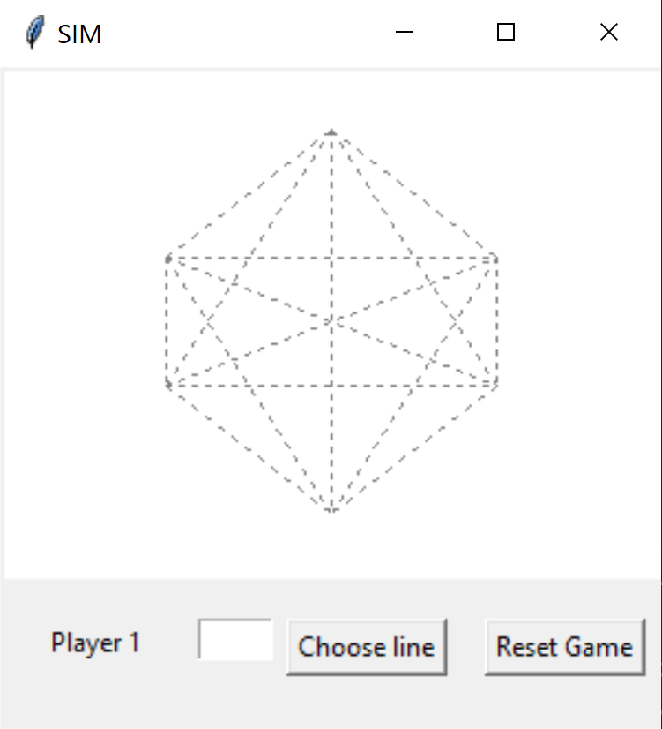
OVERVIEW
Zero Sum game
Two players take turn take turns coloring any uncolored lines (15 possible lines)
One player colors in one color, and the other colors in another color
The goal is to avoid drawing a triangle
Only triangles with the dots as corners count, intersections of lines are not relevant
Player who completes a triangle of the same color loses immediately
Each line is labeled with a letter from ‘a’ to ‘o’

Slide 3
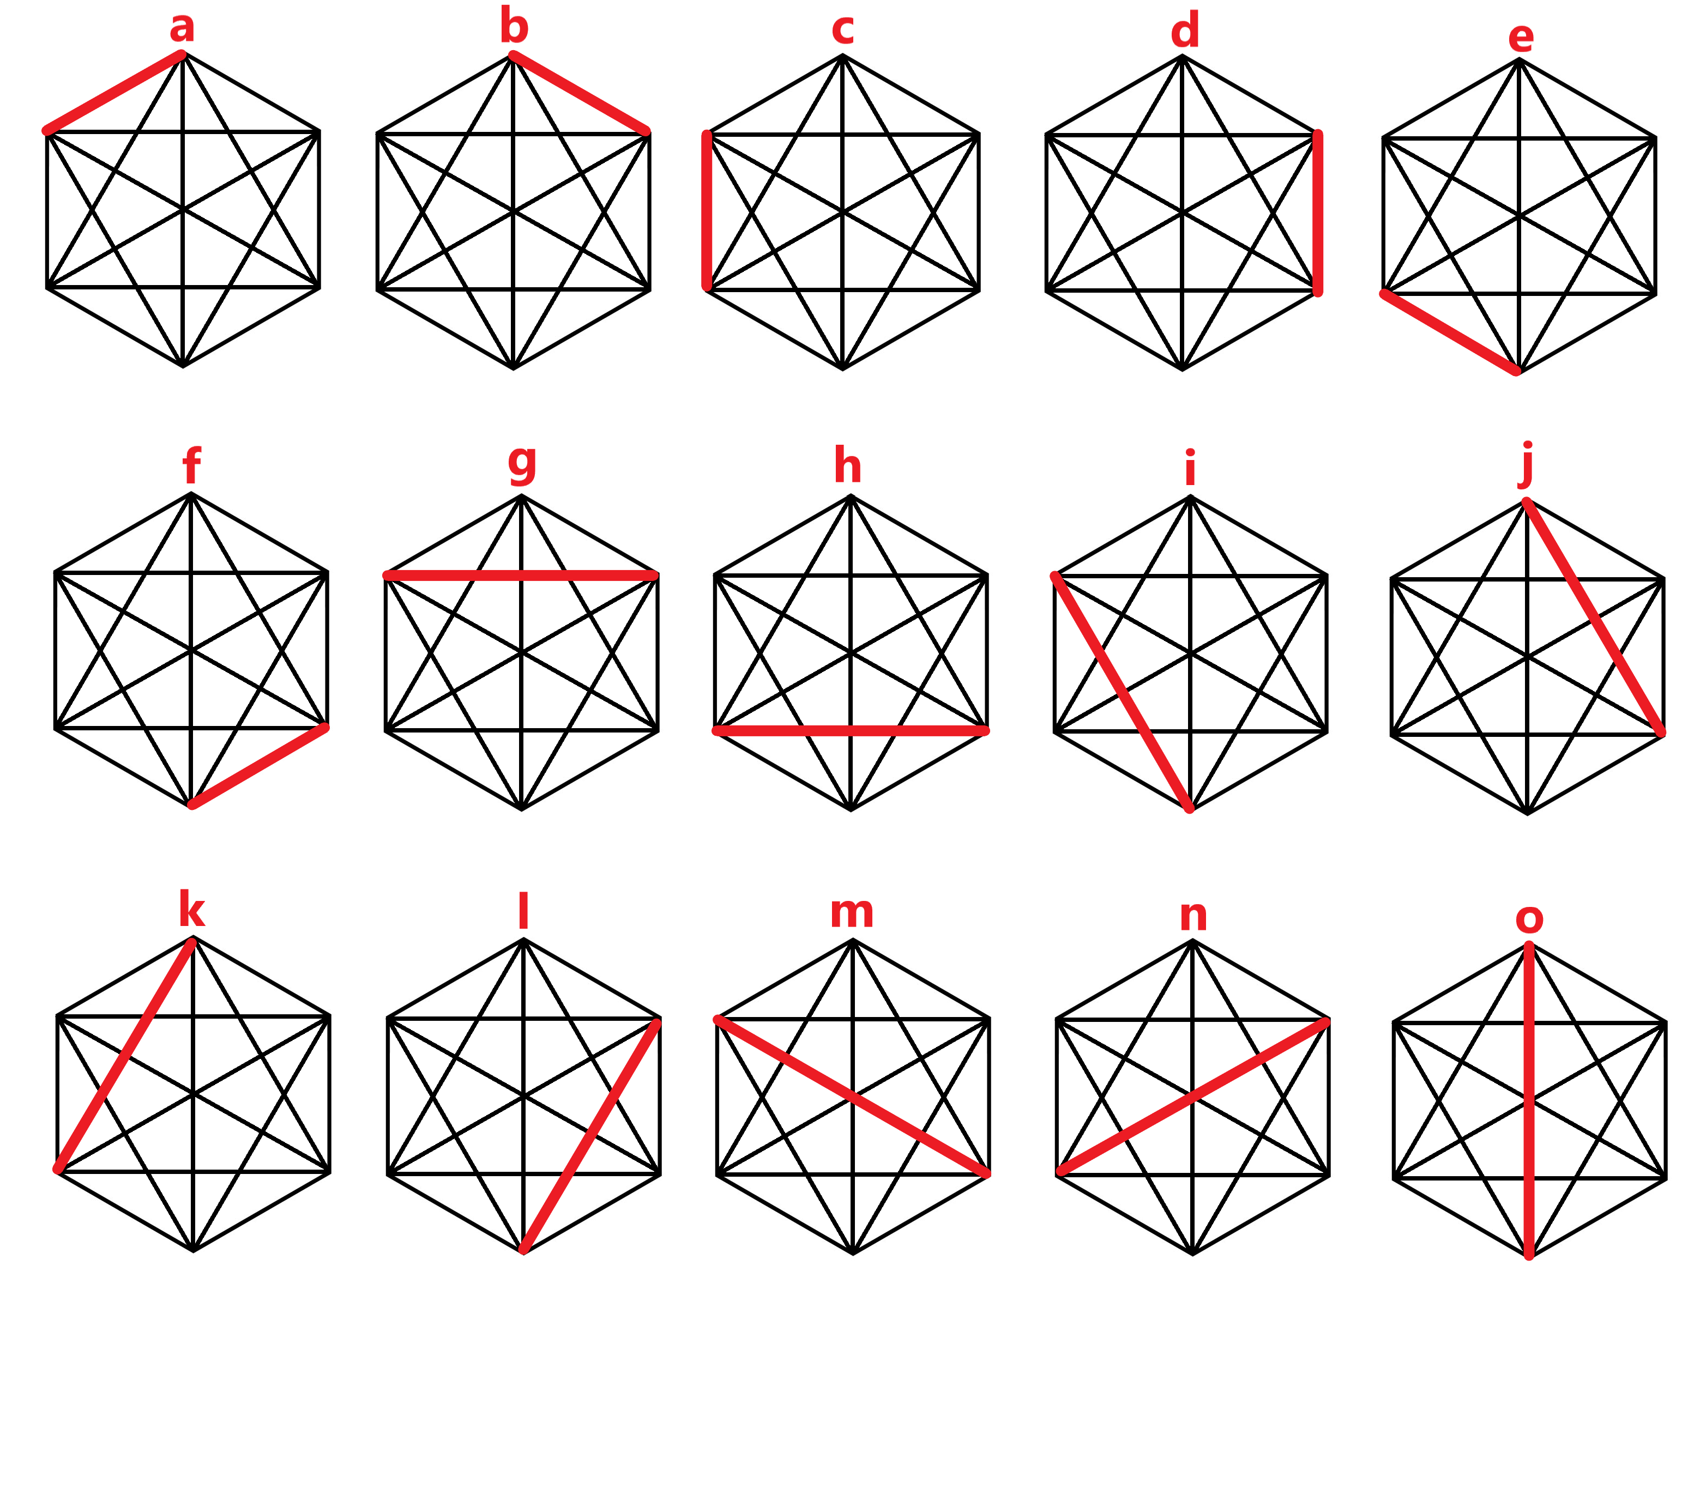

Slide 4
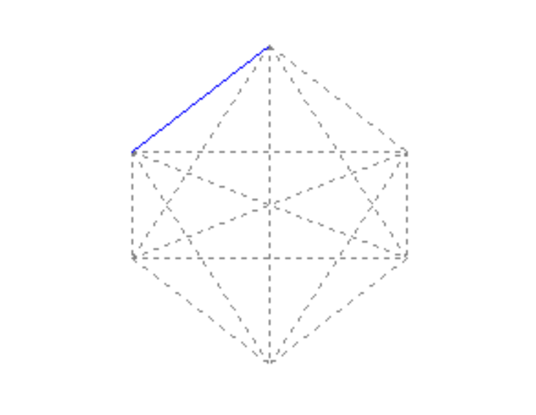
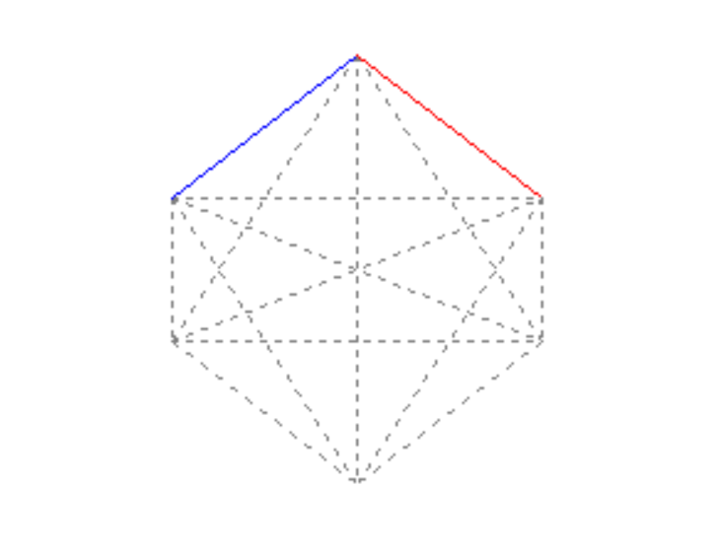
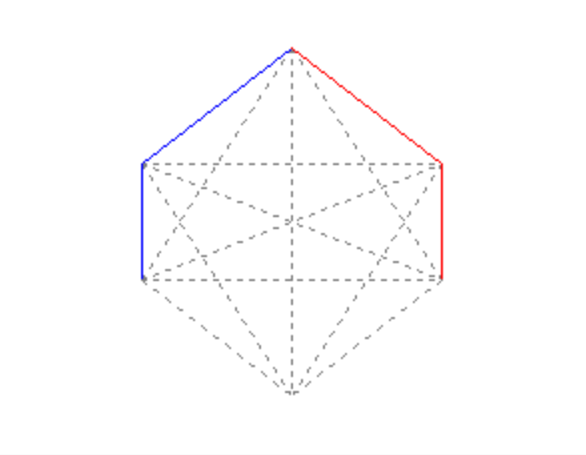

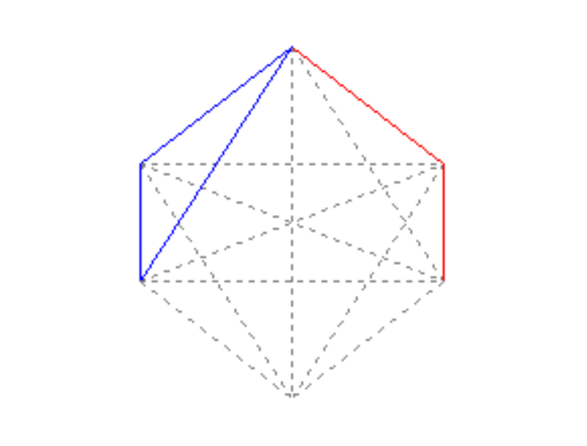
GAMEPLAY EXAMPLE
a
b
c
d
b
YOU LOST!
k

Slide 5
MINIMAX
Minimax is a recursive algorithm which is used to choose an optimal move for a player assuming that the other player is also playing optimally.
A game tree generated from current position to terminal states
Apply evaluation function to obtain values for terminal states
Determine the values of parent nodes based on the values from the terminal states (max-min-max-…etc. or vice versa)
Calculate one layer at a time until reaching the root of tree
The value of the root will be chosen as the best move

Slide 6
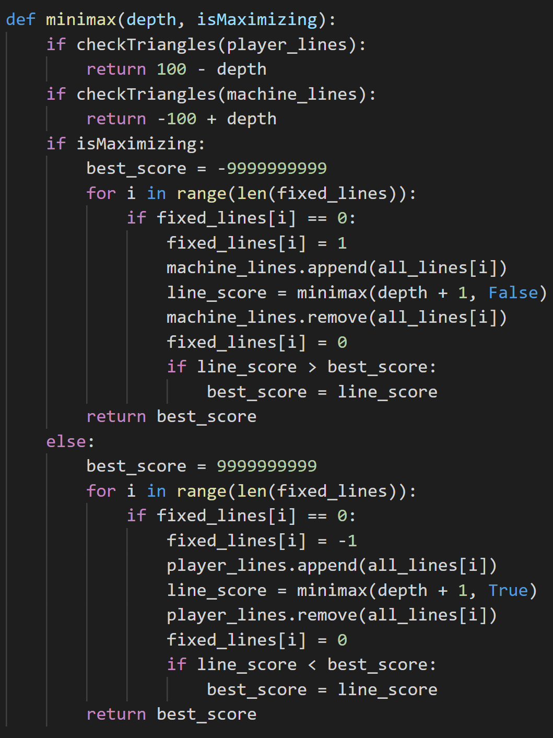
MINIMAX
Evaluation function
Minimax algorithm

Slide 7
ALPHA-BETA PRUNING
An optimization method for minimax algorithm
Applying alpha-beta pruning with minimax will return the same result.
However, it runs significant faster than standard minimax
Because it removes (prunes) all the nodes that are possibly not affecting the final decision
Alpha is the best value that the maximizer currently can guarantee at that level or above.
Beta is the best value that the minimizer currently can guarantee at that level or above.

Slide 8
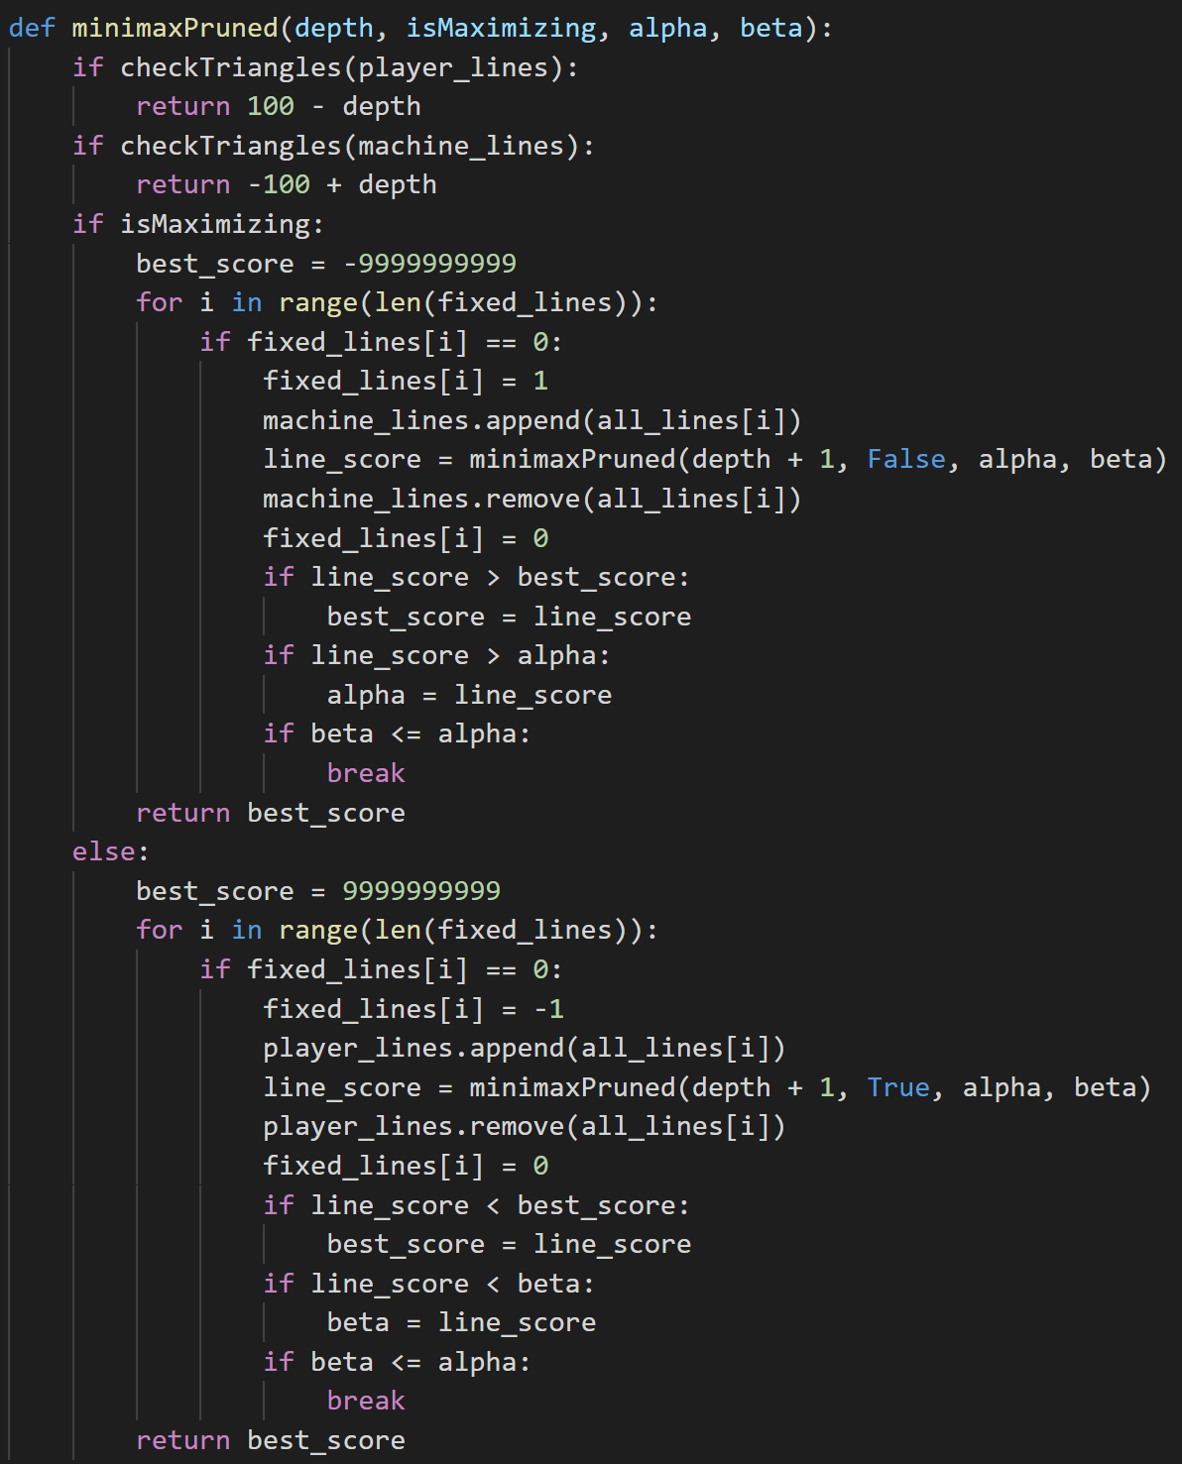
ALPHA-BETA PRUNNING
Evaluation function
Apply alpha-beta pruning to the original minimax algorithm

Slide 9
RESULTS
Minimax algorithm alone:
Played: 10 times
Human won: 0 times
Computer won: 10 times
Drawback: wait a long time for the computer to choose its next move
Alpha-beta pruning with minimax:
Played: 10 times
Human won: 0 times
Computer won: 10 times
Significant faster than the standard minimax algorithm

Slide 10
Thank you for listening!

